Slide 1
OPN
Online Posting of Needs

Slide 2
ONLINE POSTING OF NEEDS
AIM: - To fulfil daily needs of public by the help of a web application.
Used languages:- php , html, javascript, mysql

Slide 3
Need of OPN
Existing System
Olx
Amazon etc..
Emerging of OPN
Customer need satisfaction

Slide 4
DFD LEVEL 0

Slide 5
DFD LEVEL 1

Slide 6
LEVEL 2.1

Slide 7
DFD LEVEL 2.2

Slide 8
TABLES
ADMIN
FEEDBACK
ADS
CHAT
STATE
DISTRICT
CITY
USER
NEED

Slide 9
FORM
ADMIN
Adminhome.php
Needsverification.php
Adminneedhistory.php
Manageneeds.php
Feedback.php
Manageuser.php
Changepass.php
ENDUSER
Index.php
Login.php
Newaccount.php
About.php
Support.php
USER
Userhome.php
Userupdateprofile.php
Postneeds.php
Userneedstatus.php
Userreplayneeds.php
Messages.php
Chatform.php
Userfeedback.php
Changepassword.php
Usermoredetails.php

Slide 10
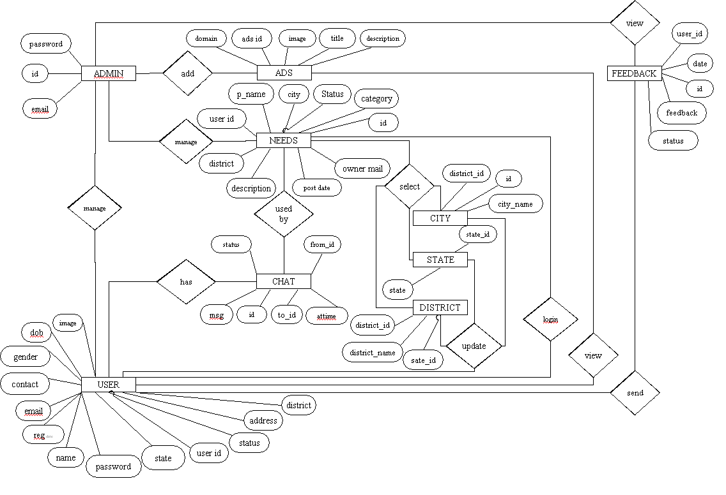
ER (Entity Relationship )

Slide 11
END

